Slide 1
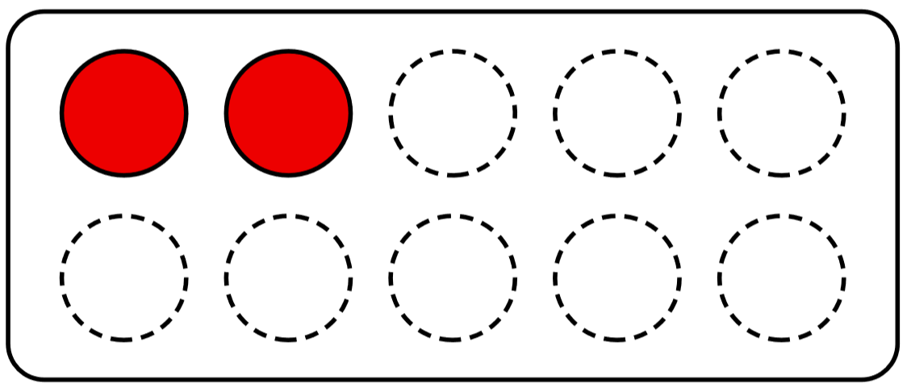

Slide 2
0

Slide 3
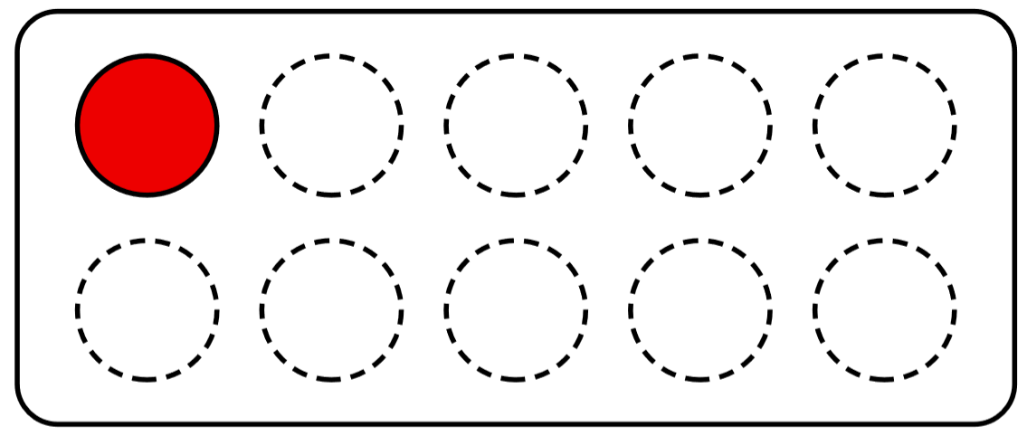

Slide 4
1

Slide 5
2

Slide 6
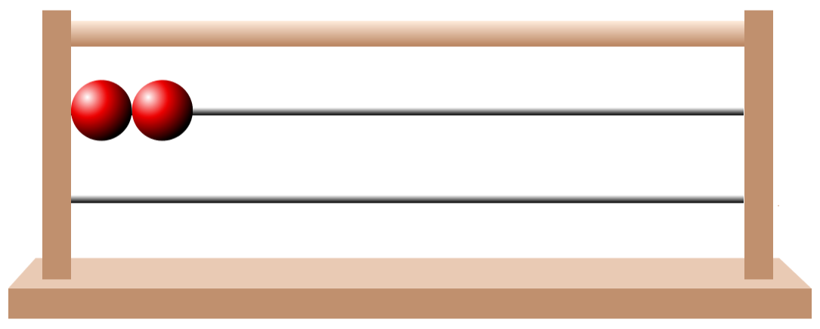

Slide 7
1

Slide 8
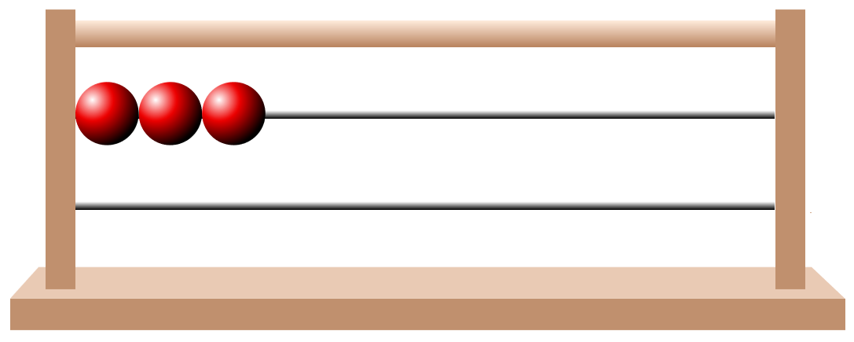

Slide 10
3

Slide 11
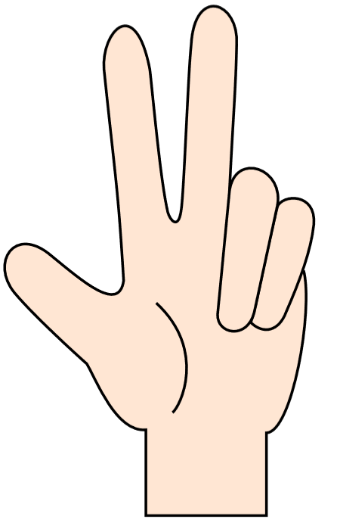

Slide 12
3

Slide 13
2

Slide 14
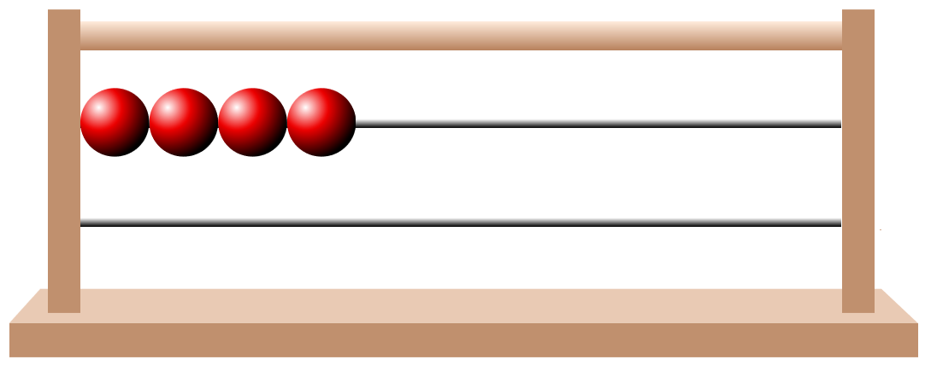

Slide 16
4

Slide 18
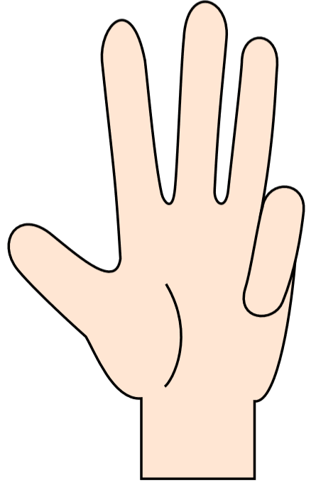

Slide 19
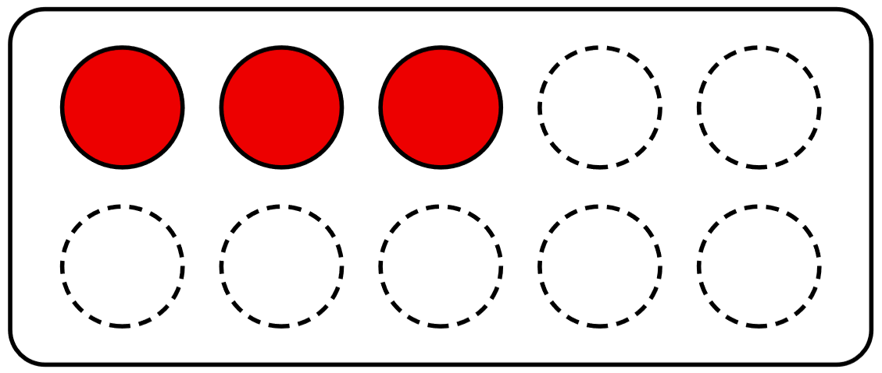

Slide 20
4

Slide 21
0

Slide 22
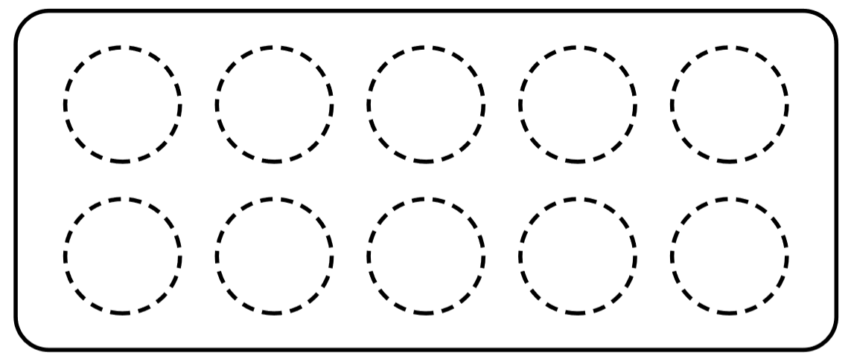

Slide 24
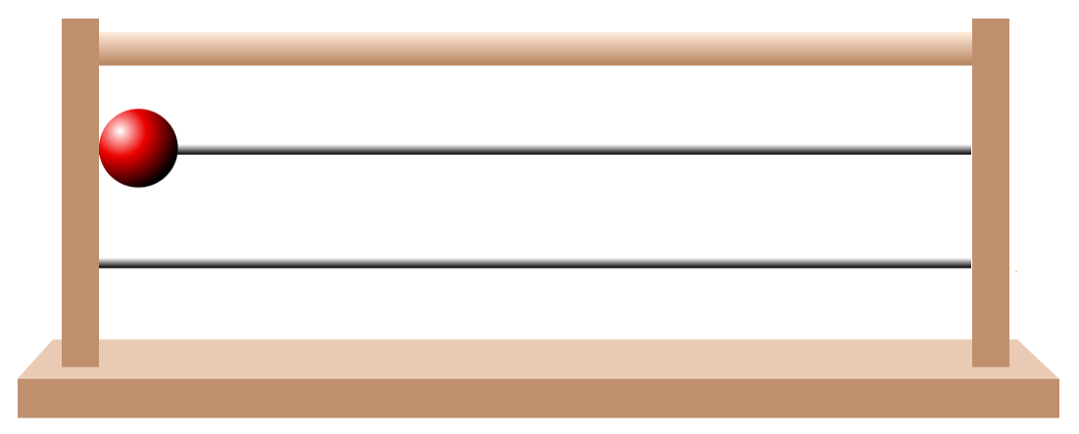

Slide 25
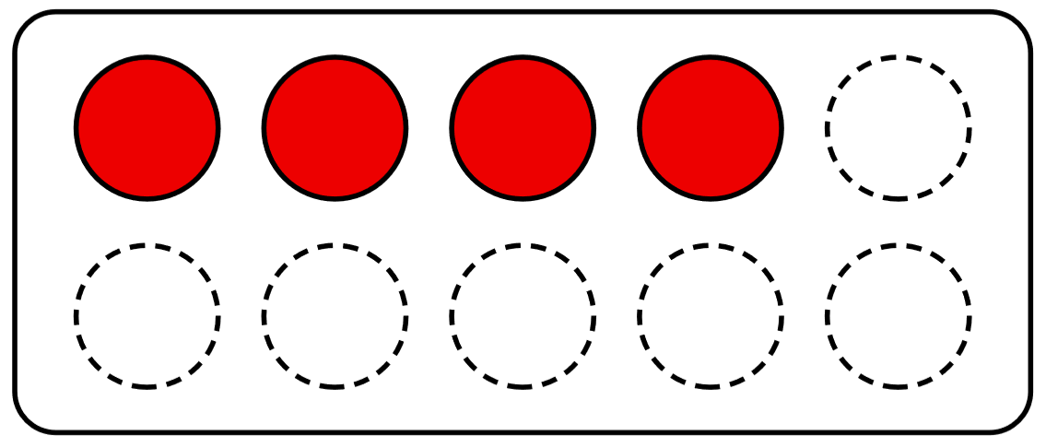

Slide 26
0

Slide 30
1

Slide 32
3

Slide 35
2

Slide 44
4

