Slide 1
Optellen tot 5

Slide 2
5 + 0 = .

Slide 3
5 + 0 = 5

Slide 4
2 + 2 = .

Slide 5
2 + 2 = 4

Slide 6
1 + 2 = .

Slide 7
1 + 2 = 3

Slide 8
4 + 0 = .

Slide 9
4 + 0 = 4

Slide 10
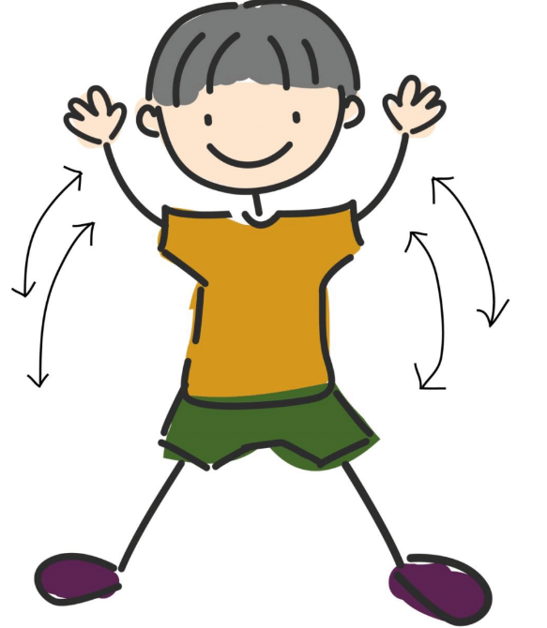
10 keer

Slide 11
3 + 2 = .

Slide 12
3 + 2 = 5

Slide 13
0 + 2 = .

Slide 14
0 + 2 = 2

Slide 15
4 + 1 = .

Slide 16
4 + 1 = 5

Slide 17
2 + 1 = .

Slide 18
2 + 1 = 3

Slide 19
sta stil

Slide 20
3 + 1 = .

Slide 21
3 + 1 = 4

Slide 22
0 + 5 = .

Slide 23
0 + 5 = 5

Slide 24
2 + 3 = .

Slide 25
2 + 3 = 5

Slide 26
1 + 3 = .

Slide 27
1 + 3 = 4

Slide 28
3 + 2 = .

Slide 29
3 + 2 = 5

Slide 30
10 keer

Slide 31
4 + 0 = .

Slide 32
4 + 0 = 4

Slide 33
1 + 1 = .

Slide 34
1 + 1 = 2

Slide 35
4 + 1 = .

Slide 36
4 + 1 = 5

Slide 37
2 + 2 = .

Slide 38
2 + 2 = 4

Slide 39
3 + 1 = .

Slide 40
3 + 1 = 4

Slide 41
0 + 0 = .

Slide 42
0 + 0 = 0

Slide 43
2 + 3 = .

Slide 44
2 + 3 = 5

Slide 45
sta stil

Slide 46
klaar

